Slide 1


Coronavirus Analysis using SQL
GONESH MAGAR

Slide 2





About This Presentation!
Data Analysis using MySQL on Coronavirus DATASET
Internship Project-2 from Mentorness
Learning the basic SQL Syntax, Statement
Demonstrating the findings with explanations.

Slide 3






Objective!!
We are given a dataset in the form of Corona Virus Dataset.csv.
We are to import .csv file into SQL workbench.
Based on the Dataset we are to solve 16 question.
We are to write 16 Queries with SQL Syntax and Statement.
Provide the solution and findings for our project.

Slide 4




GOALS !!
The basic goals of this projects is to understand MySQL work bench.
Understanding Basic Statement of SQL.
Analysing Cumbersome Data into simple format

Slide 5

Ways to load your data in MySQL
Method-1
Method-2
Step 1: Connect to your workbench server.
Step 2: On the Navigator bar Select ‘Schemas’
Step 2: Create a schema.
Step 4: Open Schema>Right Click to open options.
Step 5: Select Table Data Import Wizard.
Step 6: Browse the .csv file in your PC and click OK.
Step 7: Check your DataType and finish.
CREATE DATABASE IF NOT EXISTS Coronadb;
USE Coronadb;
CREATE TABLE CoronaTb
(
Province TEXT,
Country_Region TEXT,
Latitude FLOAT,
Longitude FLOAT,
Date DATE,
Confirmed INT,
Deaths INT,
Recovered INT
);
SELECT * FROM CoronaTb;
LOAD DATA INFILE 'C:/CoronaDataset.csv' INTO TABLE CoronaTb
FIELDS TERMINATED BY '\t'
IGNORE 1 LINES;
Using Database
Table description with DataTypes
While method 1 & 2 both works
-difference is Method 1 is time consuming
-Method 2 we need to check secure-file-priv in C:\ProgramData\MySQL\MySQL Server 8.0\my.ini file
Loading the CSV file

Slide 6

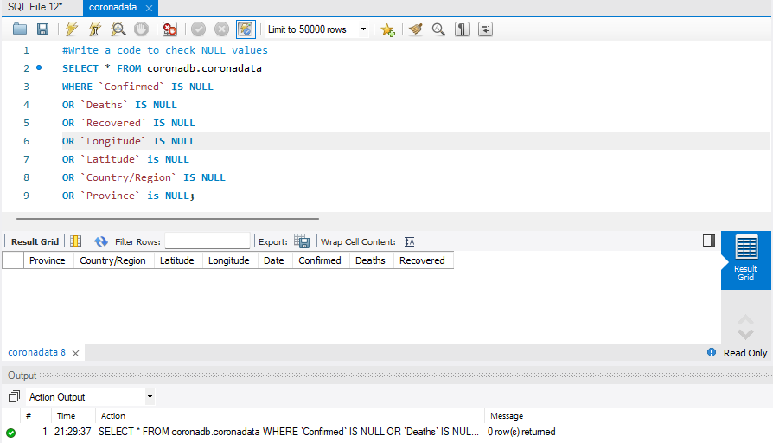
Findings
Q1. Write a code to check NULL values
Using Basic Syntax like IS NULL or IS NOT NULL
The result return here is blank because our dataset does not contain NULL values

Slide 7
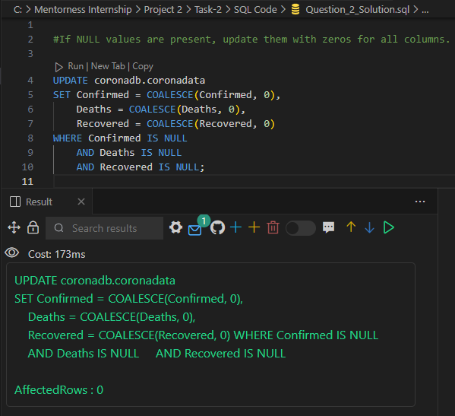
Findings
Q2. If NULL values are present, update them with zeros for all columns.
UPDATE Statement - updates the null values with zeros for all columns where the Confirmed, Deaths, and Recovered columns are null.
COALESCE function in SQL is used to return the first non-null value in a list of expressions. If Confirmed is Null it returns 0, if not NULL returns the value of the Confirmed column.
The AffectedRows is 0 because our dataset doesn’t contain null values

Slide 8
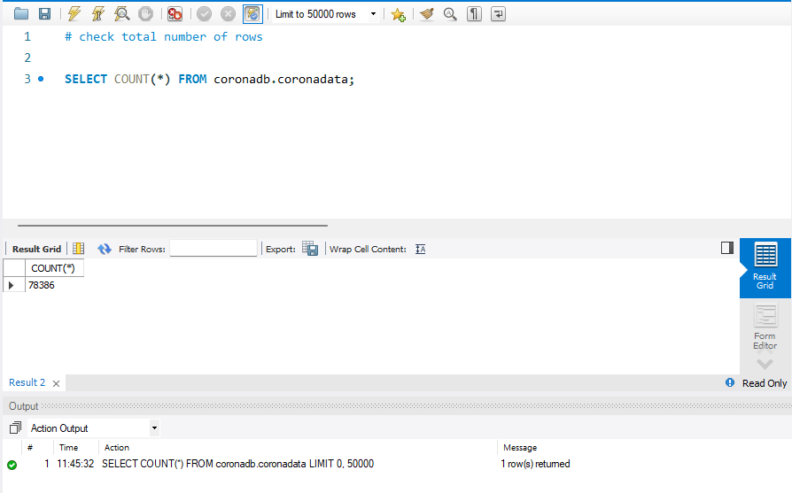
Findings
Q3. check the total number of rows
The Count (*) Syntax is used to count the number of rows in a table or a result set.
It Returns 78386 as our dataset contain that number of rows

Slide 9
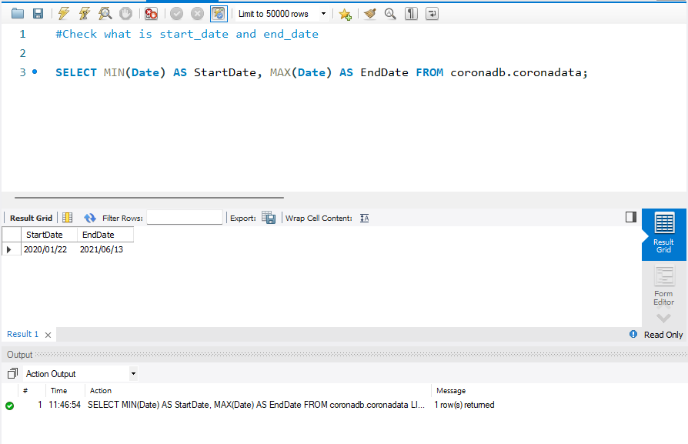
Findings
Q4. Check what is start_date and end_date
We use the MIN function to check the start_date and rename it AS the StartDate column. Similarly, the MAX function checks end_date and renames it AS the EndDate column. We
The results from the dataset.

Slide 10
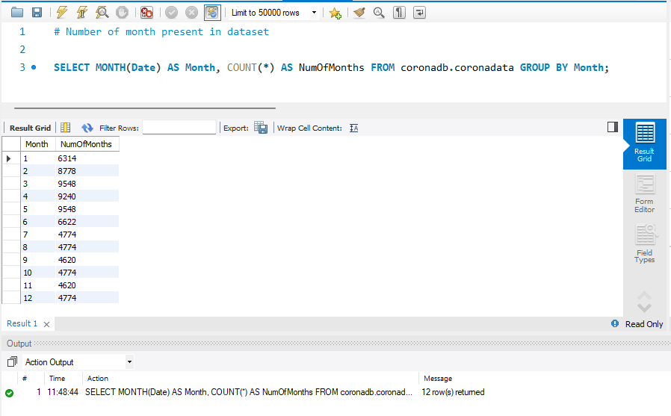
Findings
Q5. Number of month present in dataset
The MONTH function in SQL is used to extract the month from a date value.
This is the month Present in our dataset.

Slide 11
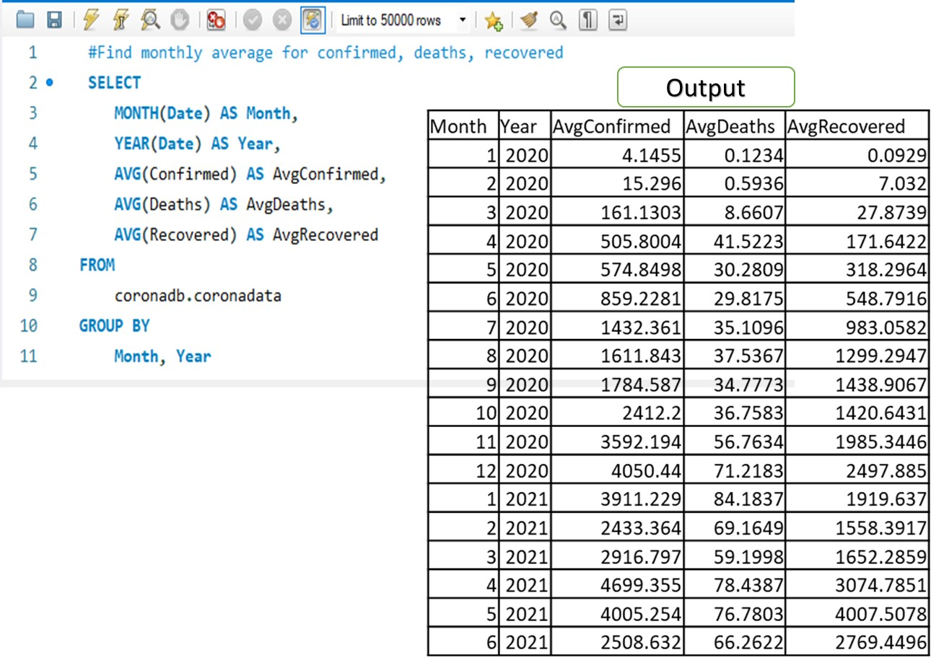
Findings
Q6. Find monthly average for confirmed, deaths, recovered
YEAR function to extract the year from the date value.
AVG function to calculate the Average value in a column or result set

Slide 12
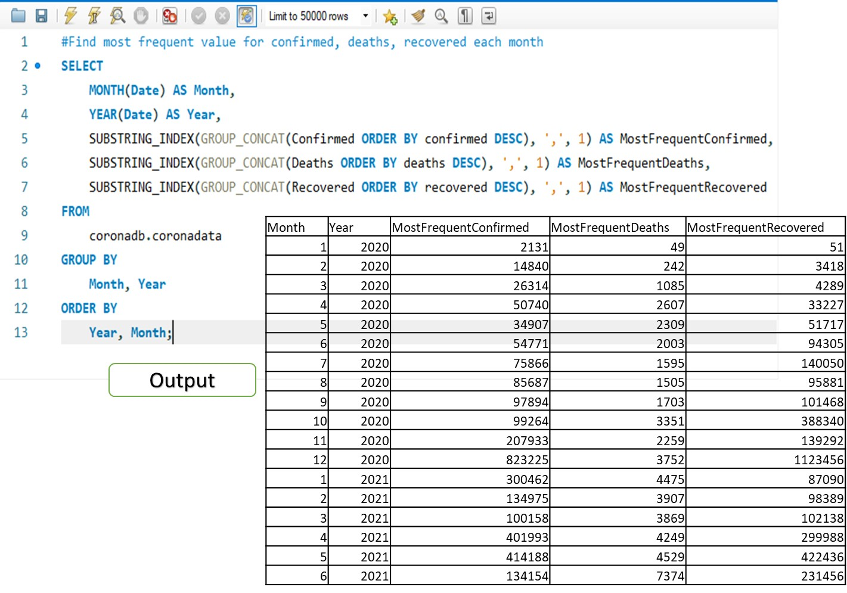
Findings
Q7. Find most frequent value for confirmed, deaths, recovered each month
Descending
GROUP_CONCAT function concatenates all the values in the ’column_name’ column into a single string, separated by commas.
SUBSTRING_INDEX function then extracts the first value from the concatenated string, which is the most frequent value.

Slide 13
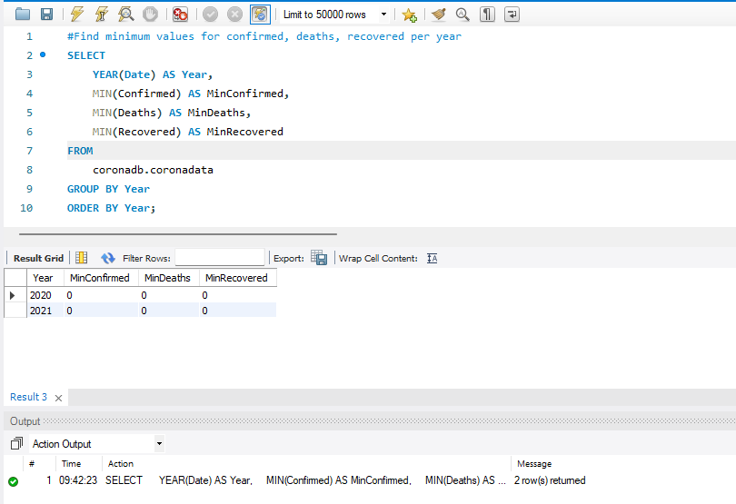
Findings
Q8. Find minimum values for confirmed, deaths, recovered per year
MIN function in SQL is used to find the minimum value in a column or a result set.
The output result.

Slide 14
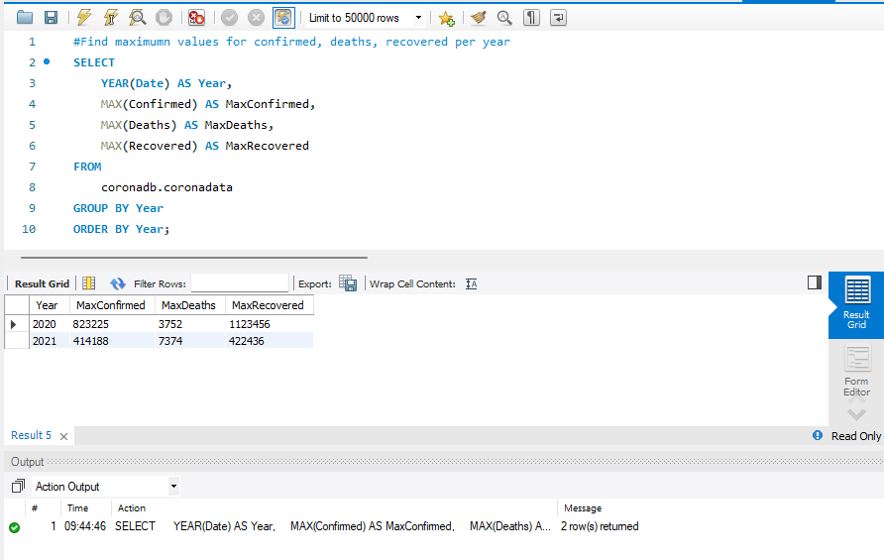
Findings
Q9. Find maximum values of confirmed, deaths, recovered per year
MAX function in SQL is used to find the maximum value in a column or a result set.
The output result.

Slide 15
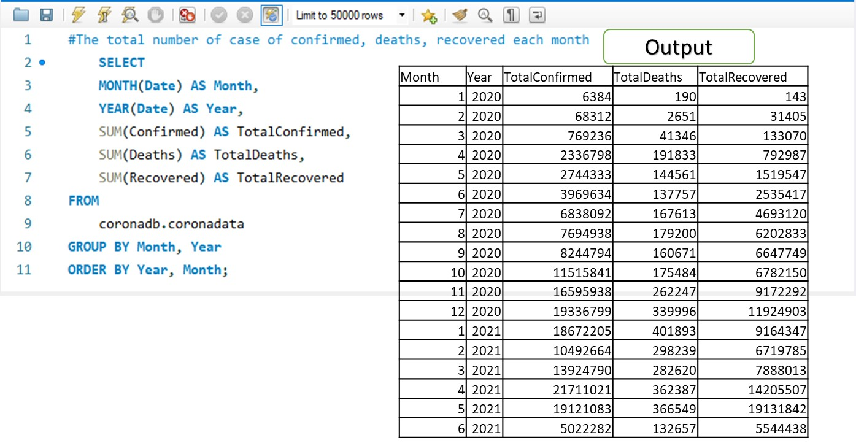
Findings
Q10. The total number of case of confirmed, deaths, recovered each month
The SUM function is used to calculate totals in columns or result set.

Slide 16
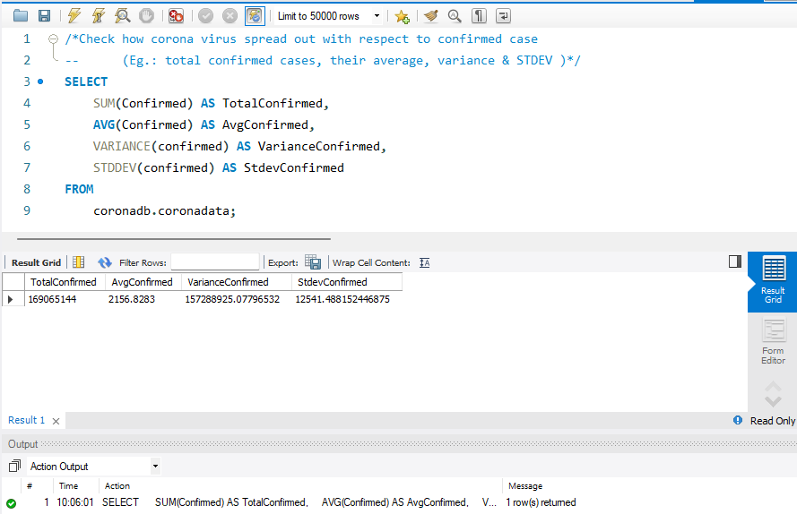
Findings
Q11. Check how coronavirus spread out with respect to confirmed case
--(E.g.: total confirmed cases, their average, variance & STDEV )
AS keyword renames the result
The VARIANCE function in SQL is used to calculate the variance of a column or a result set
STDEV function in SQL is used to calculate the standard deviation of a column or a result set
The output result.

Slide 17
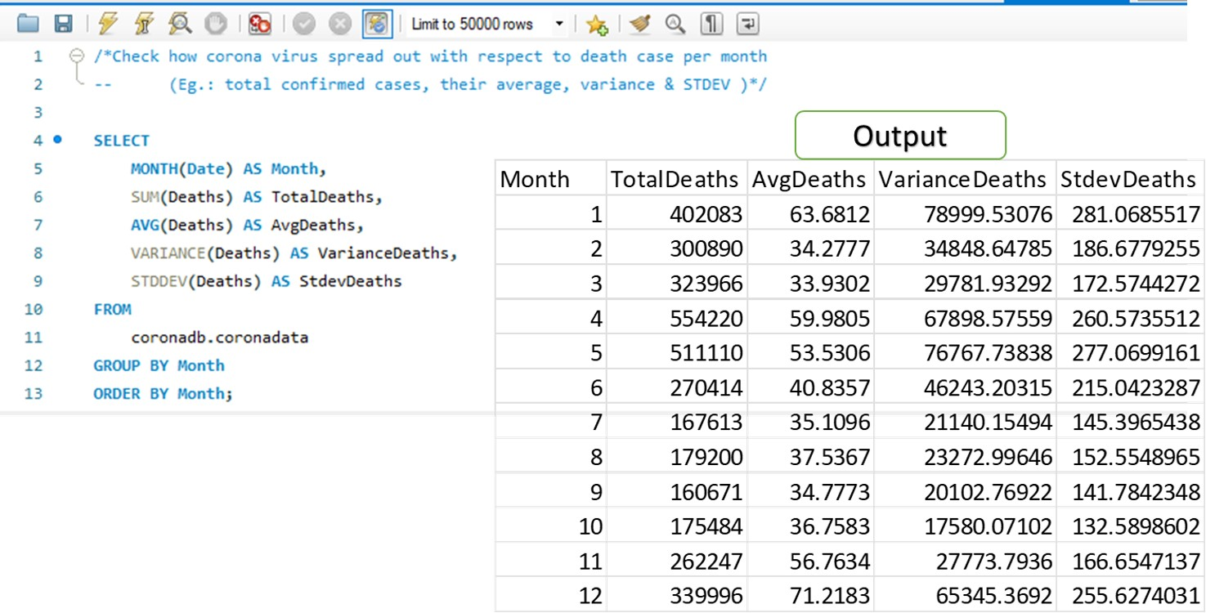
Findings
Q12. Check how coronavirus spread out with respect to death case per month
(E.g.: total confirmed cases, their average, variance & STDEV )
The MONTH function in SQL is used to extract the month from a date value.

Slide 18
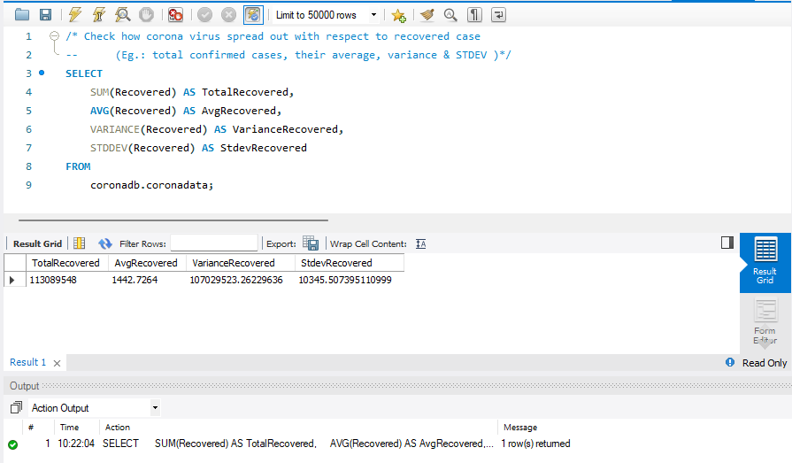
Findings
Q13. Check how coronavirus spread out with respect to recovered case
(E.g.: total confirmed cases, their average, variance & STDEV )
Checking with respect to recovered case
The output result.

Slide 19
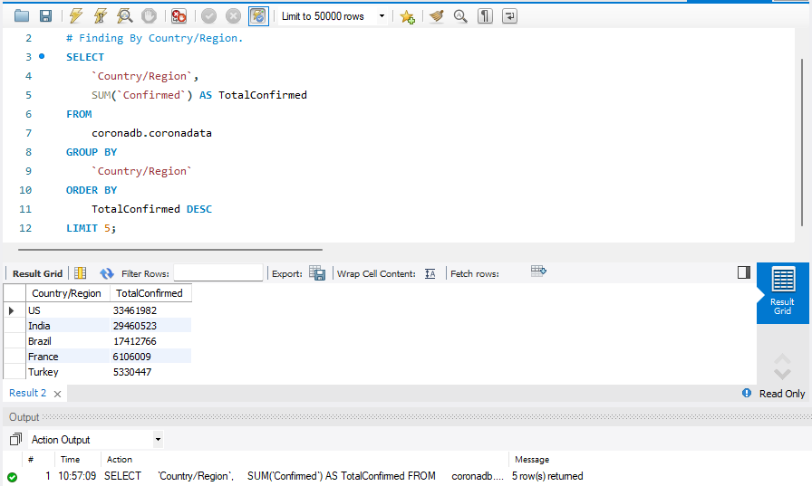
Findings
Q14. Find the Country having highest number of Confirmed case
Targeted Column
Calculate the Total and renaming result using the AS Keyword
LIMIT (set to 1 for a single result)
The output result.

Slide 20
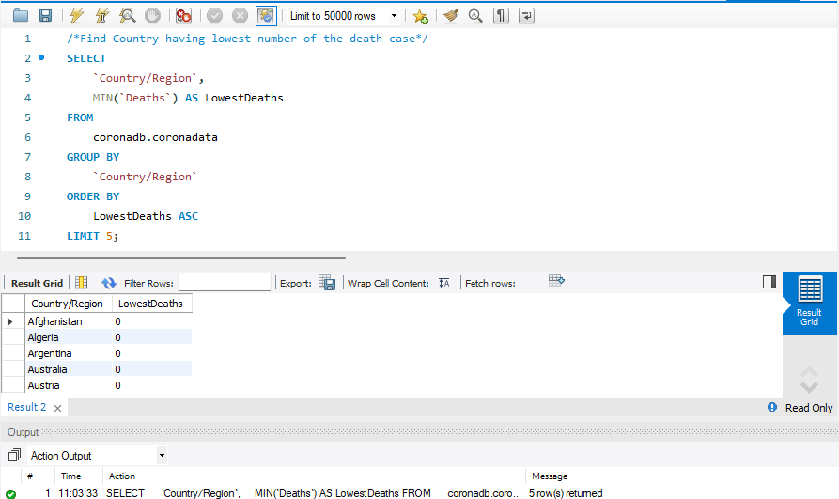
Findings
Q15. Find Country having lowest number of the death case
ASC keyword to arrange in ascending order
The output result.

Slide 21
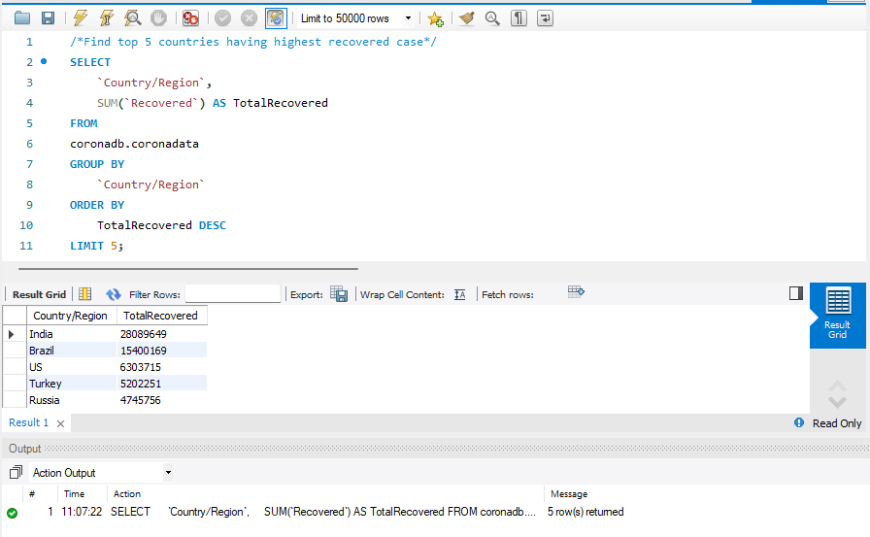
Findings
Q16. Find top 5 countries having the highest recovered case
Finding the top 5 countries with LIMIT 5 in recovery case.
The output result.

Slide 22





Conclusion
When a large dataset is present breaking them into smaller segment should be priority.
With MySQL Function, Statement, Syntax, and Keyword deducing the outcome into simple required format is easier.
Checking Dataset, Datatypes compatibility of your data with MySQL should be handled before diving in.
Cross checking in different platform e.g.: Vs Code using MySql Extensions helps to understand the results better.

Slide 23

GONESH MAGAR

